Slide 1

COVID-19 Data Insights:
From Analysis to Visualization
Emily Nguyen, Riddhi Athreya
Data Management and Processing
Notes:
Opening:
(Introduce yourselves - Emily First, then Riddhi)
Our project is about COVID-19 Data Insights, from Analysis to Visualization!
In this presentation, we’ll explore how COVID-19 unfolded across regions, its human cost, and the power of recovery—all through the lens of data.

Slide 2


Introduction - Objectives and Goals
Objectives
Goals
Implement a Big data storage solution using Hadoop.
Enable fast data processing for batch data using Spark.
Develop an interactive UI dashboard to visualize insights.
Ensure data integrity and accuracy through preprocessing.
Build a platform capable of handling datasets efficiently.
Create extensive documentation and a final project report.
Notes:
Our objective and goals are to build a big data system using Hadoop for storage and Spark for fast processing, plus a nice dashboard to see everything clearly. Our main goals are to keep the data clean and accurate, handle large datasets efficiently, and document everything well.

Slide 3
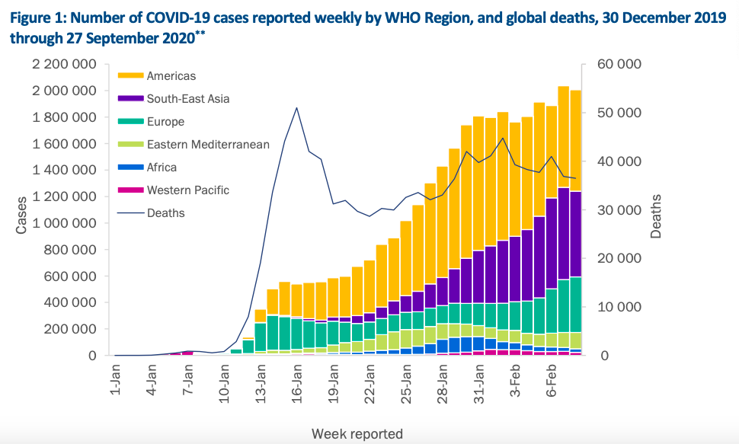
Introduction - Background and Motivation
Q: What good is a dashboard ?
A: Humans understand and remember visual information better
How does COVID-19 compare to other major causes of death?
Since late December 2019, COVID-19 has spread rapidly worldwide, with cases rising significantly across different regions. The Americas have been the most affected, reporting the highest number of cases and experiencing a consistent surge over time. South-East Asia and Europe have also faced substantial increases, though at slightly lower levels. Other regions, such as the Eastern Mediterranean, Africa, and the Western Pacific, have reported more moderate but steady growth in cases. ………….
V/S
Notes:
why do you think dashboards are so widely used in today’s world?
the key lies in how humans process information. As we’ll see here…
On the left, we have a narrative—an explanation of how COVID-19 cases spread globally. It's detailed but text-heavy, which can take time to process.
On the right, the same story unfolds, but visually, which is easier to process and follow
Humans understand and remember visual information better!
Riddhi

Slide 4


Literature Review
Relevant Existing Work:
Prior studies demonstrated the potential of Big Data technologies for analyzing large-scale healthcare datasets. [https://data.who.int/dashboards/covid19/cases]
Existing platforms on case-tracking, forecasting, and basic visualizations. However, most of these dashboards have stopped tracking data long ago. [https://coronavirus.jhu.edu/map.html]
There are many articles and reports talking about cases and statistics detailing events of covid as it happened. [https://www.worldometers.info/coronavirus/coronavirus-death-rate/]
Novelty of our project:
Our project introduces a scalable platform capable to handling large datasets, using Hadoop, Spark, and Hive.
Focused on interactive visualizations for actionable insights, beyond static reporting.
New Visualizations including correlation heatmaps and pie charts.
Notes:
Literature Review!
As for relevant existing work, prior studies demonstrate the potential of Big Data technologies for large-scale healthcare analysis, with some existing COVID-19 tracking platforms and such now outdated.
There are many articles and reports about covid-19 statistics.
Correspondingly, our project introduces a scalable platform capable of handling large datasets, using Hadoop, Spark, and Hive which are Big Data technologies, also offering interactive visualizations beyond static reporting like heatmaps and pie charts for actionable insights.
Emily

Slide 5
Methodology
Notes:
The methodology focuses on a distributed system architecture, starting with data ingestion into HDFS, preprocessing with Spark, and storing the cleaned data in Hive tables. By leveraging broadcast variables and optimized data structures, the platform ensures scalability and efficiency.

Slide 6





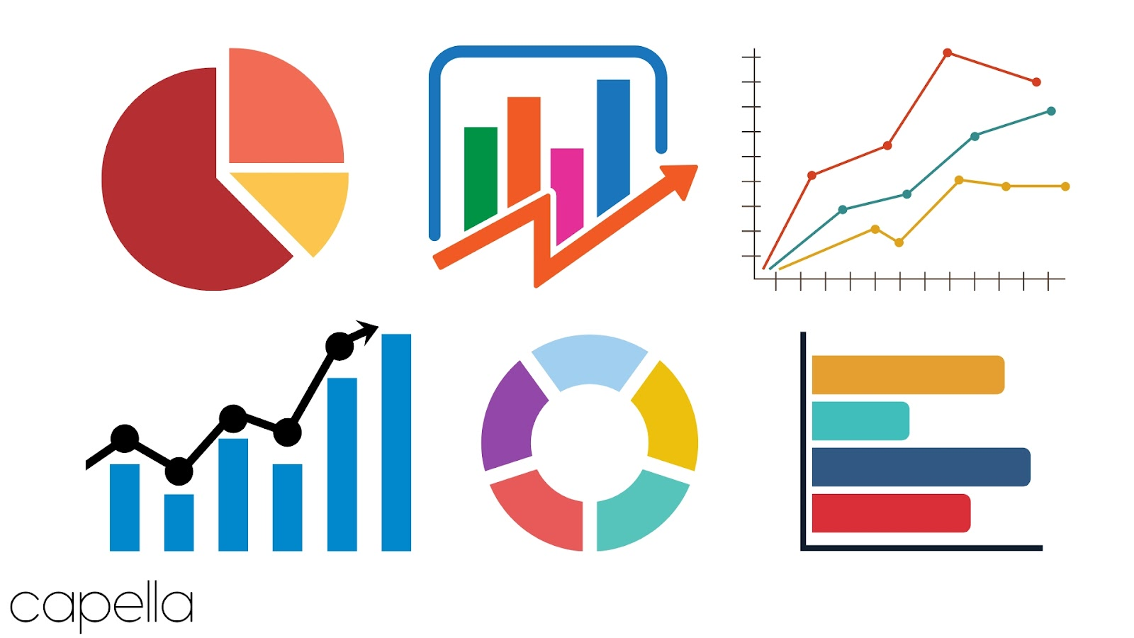



Methodology: Workflow
Data Ingestion
Data Preprocessing
Data Storage
Visualization
News API
Covid dataset
Notes:
Transforming raw data into meaningful insights requires a seamless workflow. This diagram shows how we process COVID-19 data—from collection to visualization
Riddhi

Slide 7
Methodology: Data Ingestion
Daily CSV files spanning the past three years. Each file includes the following columns:
Country_Region , Last_Update , Lat, Long_ ,Confirmed, Deaths, Recovered, Active , Combined_Key , Incident_Rate, Case_Fatality_Ratio
News API to fetch the latest COVID-19-related news in JSON format,
News API
Covid dataset
Notes:
Data Ingestion is the process involving collecting and consolidating data from multiple sources into a central location for storage, processing, and analysis.
We extracted this data from the CSV files and organized it into a centralized table for further analysis.
Our dataset consists of daily CSV files spanning the past three years. Each file includes the following columns:
Country_Region , Last_Update , Lat, Long_ ,Confirmed, Deaths, Recovered, Active , Combined_Key , Incident_Rate, Case_Fatality_Ratio
We also utilize a News API to fetch the latest COVID-19-related news in JSON format, ensuring our data remains up-to-date with real-world developments.
Riddhi

Slide 8
Methodology: Data Preprocessing
1. Handle Missing Data
2. Check for Duplicate Rows
3. Correct Inconsistent Formatting
News API
Covid dataset
Notes:
1. Handle Missing Data
Filled missing values with 0
For categorical fields like country names: remove rows with empty country names and fixed typos,
2. Check for Duplicate Rows:
Drop duplicates if found..Duplicates were found for repeated entries for the same country and date.
3. Correct Inconsistent Formatting
Ensure all dates are in a uniform format
Check for inconsistencies (e.g., "United States" vs. "US").Standardize using a reference list of country names.
Riddhi

Slide 9
Methodology: Data Storage
Structured data is stored in Hive tables for SQL-like querying and analytics.
News API
Covid dataset
Notes:
Structured data is stored in Hive tables, enabling SQL-like querying and analytics over large datasets.
Hive, built on the Hadoop framework, ensures efficient data organization and accessibility.
Emily

Slide 10
Methodology: Visualization
Processed data is visualized in a user-friendly dashboard. Using the Panel library for the dashboard layout (FastListTemplate) to organize dashboard components and widgets.
Using Plotly library for creating interactive and dynamic visualizations.
News API
Covid dataset
(MAYBE ADD) → Description of Methods and Techniques Used
Data Integration:
Preprocessed data is stored in structured DataFrames (pandas), then dynamically queried for interactive visualizations.
Utilized callback functions to ensure real-time updates to widgets and visualizations based on user interaction.
Notes:
Next is data visualization.
To present the processed data in a meaningful and user-friendly way, we designed a dynamic dashboard using the Panel library’s FastListTemplate, a dashboard layout, to organize components and widgets.
Plotly library was employed to create interactive and dynamic visualizations.
Emily

Slide 11
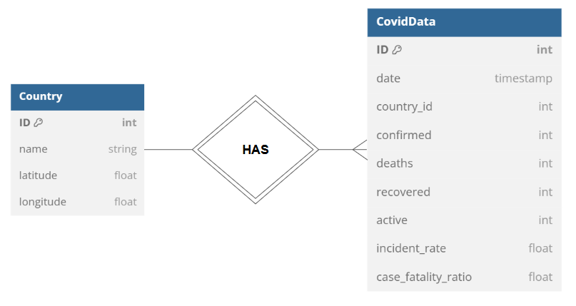
Methodology: ER Diagram
Notes:
This is our ER Diagram. Country is the parent entity, while CovidData is the child entity. They have a one to many relationship. The CovidData entity has the PK, ID, with the foreign key country_id referencing the primary key, named ID, in the Country entity.
Emily

Slide 12
Analysis and Results
Notes:
Next are our analysis and results!

Slide 13
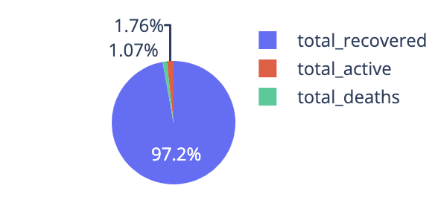
Analysis and Results: Global Statistics
(595,786,992)
(10,796,564)
(6,530,942)
Total Cases: 613,114,498
Total Cases: 613,114,498
Notes:
This pie chart illustrates global COVID-19 statistics, with over 613 million total cases reported.
Recoveries dominate at 97.2%, reflecting the significant recovery efforts worldwide. Active cases account for 1.76%, while deaths represent 1.07%, highlighting the pandemic's ongoing impact alongside the large number of recoveries.
Emily

Slide 14
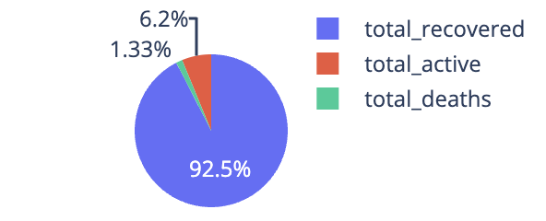
Analysis and Results: United States Statistics
(
(49,763,187)
(3,338,301)
(713,564)
Total Cases: 53,815,052
Total Cases: 53,815,052
Notes:
Here we can see the pandemic's impact within the US country, with over 53 million total cases reported.
The majority, 92.5%, are recoveries, showcasing the effectiveness of treatment efforts. Active cases make up 6.2%, while deaths account for 1.33%, emphasizing both the challenges and progress in managing the pandemic domestically.
Emily

Slide 15
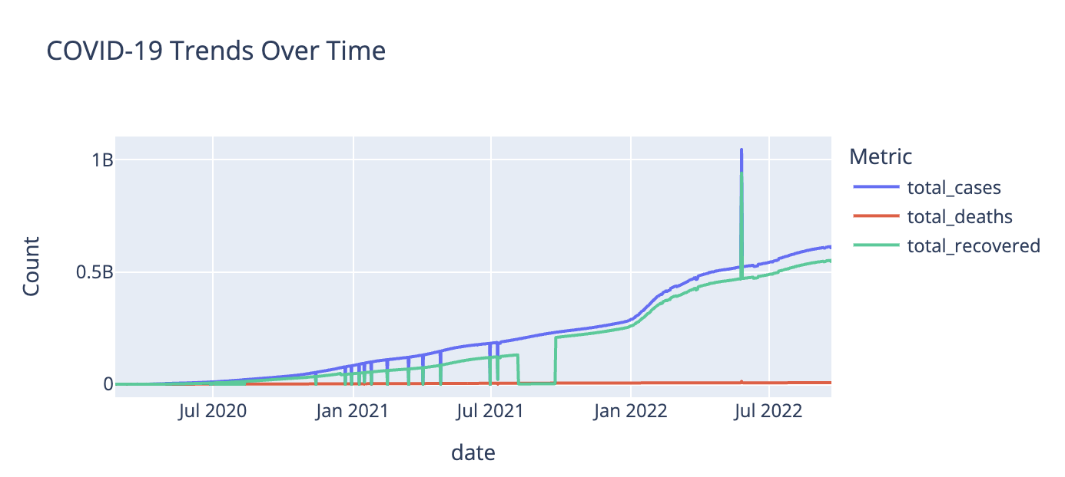
Analysis and Results: Trends Over Time
Steady and cumulative increase over the observed period
Total recovered closely follows the total cases
Total deaths remain significantly lower in comparison
Notes:
This slide shows COVID-19 trends over time, tracking total cases, recoveries, and deaths.
The blue line reflects the steady rise in total cases, while the green line mirrors this growth, highlighting recovery progress.
The red line, representing deaths, remains significantly lower but continues to trend upward.
Emily

Slide 16
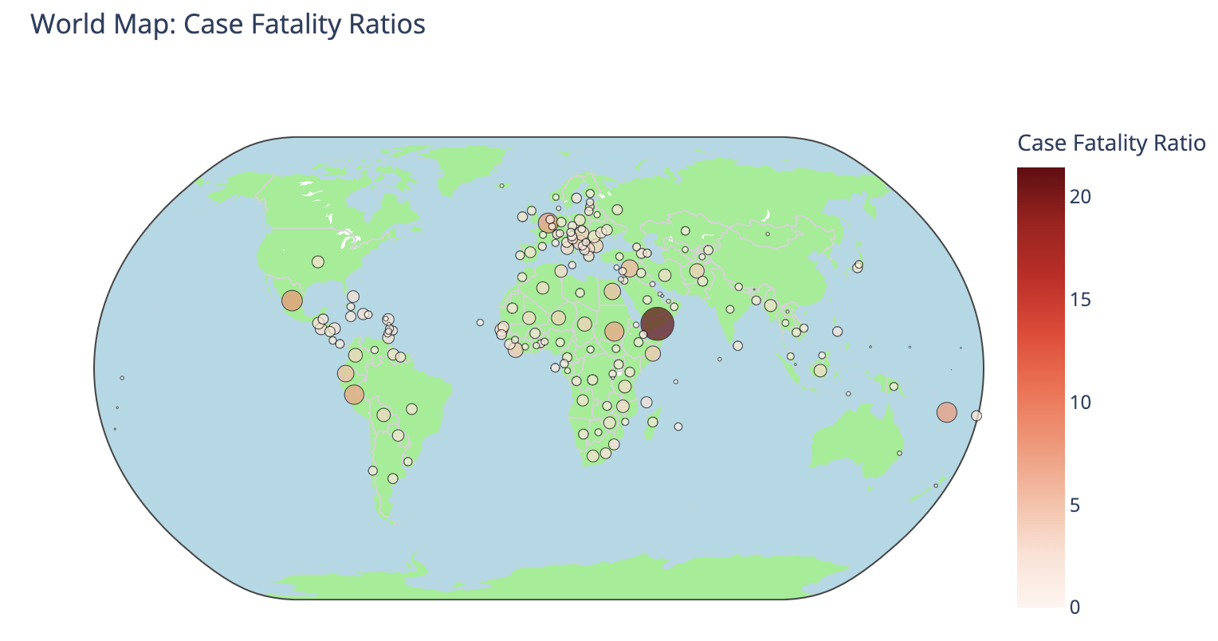
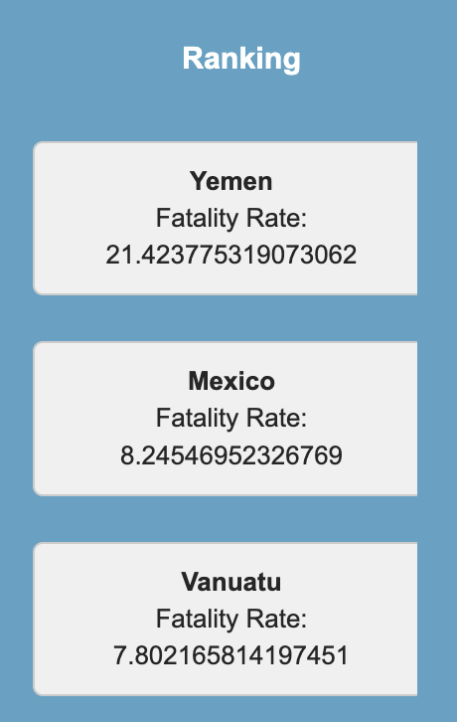
Analysis and Results: World Map
Displays global case fatality ratios geographically.
Darker red regions indicate higher fatality ratios.
Highlights noticeable global variations in the impact of COVID-19
Notes:
This map shows global COVID-19 case fatality ratios, with darker red areas indicating higher fatality rates.
We found that Yemen stands out as the most affected, followed by Mexico, as seen in the rankings.
The map highlights significant global variations, reflecting disparities in healthcare and pandemic response.
Riddhi

Slide 17
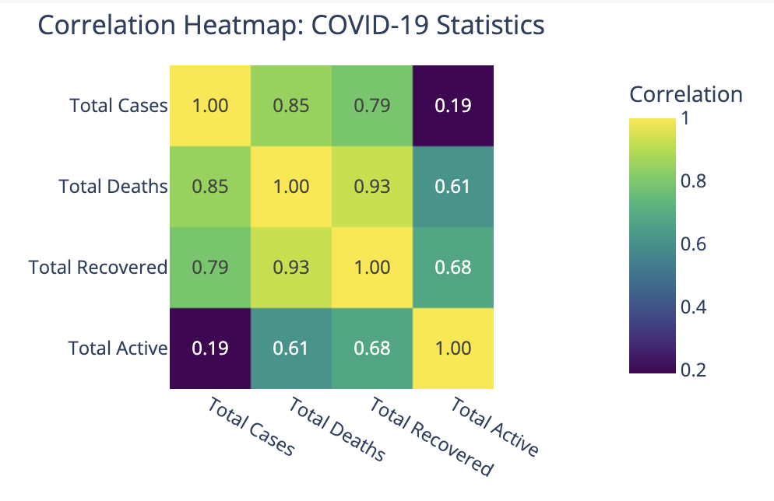
Analysis and Results: Correlation Heatmap
Visualizes relationships between COVID-19 variables like total cases, deaths, recoveries, and active cases.
Strong Correlations: Total cases ↔ Total deaths (0.85) and total recovered ↔ Total deaths (0.93).
Weaker Correlation: Total active cases ↔ Total cases (0.19), indicating independent fluctuations.
Notes:
This is the correlation heatmap
The yellow squares show us where the strongest relationships.When total cases increase, we see deaths rising in tandem with a strong correlation of 0.85. Interestingly, active cases don't follow this pattern, showing a much weaker relationship with total cases at just 0.19. This tells us that while deaths and recoveries tend to move together with total cases, the number of active cases at any given time seems to follow its own independent pattern.
Riddhi

Slide 18

Demo Time!
Notes:
Sidebar - which can collapse
Global Statistics corresponding to Pie Chart of COVID-19 Statistics
You may select a specific country that you want to view the statistics of
It’s defaulted to Afghanistan but, we can check Liberia
Corresponds to pie chart below the global
Hover tooltip
Lastly! There is a section of links to COVID-19 News
For ex, you can just press on the link
In the main page,
Correlation Heatmap of COVID-19 Statistics
Hover over it to show the variables considered and correlation value
Trend Line
Can zoom in
Choose to remove lines from the graph
Hover to see specific dates and values
Tab 2:
Hover over points to view fatality rates, as well as longitude and latitude and the country
Move around the map
Box select to view a specific region
Ranking with the worst fatality rates on top - scroll!

Slide 19




Implications of Findings
Insights may inform resource allocation, healthcare planning, and policy decisions to identify best practices and lessons for other regions.
The interactive dashboard shows the power of data-driven decision making in global health crisis.
Findings highlight the fact that the mortality rate of COVID is 1.07%.
Cases ∝ Deaths
Geographic disparity analysis can be used to strengthen healthcare in high fatality rate areas.
Notes:
The interactive dashboard itself shows the power of data-driven decision-making in tackling global health crises.
Findings also highlight that the mortality rate of COVID is 1.07%
Geographic disparities imply to strengthen healthcare infrastructure-which may include vaccines, medical supplies, health care professionals-in regions with high fatality rates.
Insights may inform resource allocation, healthcare planning, and policy decisions.
Emily

Slide 20


Project Limitations
Bias in Data
Underrepresented Regions
Regional differences in testing and reporting standards can affect analysis.
Over-representation or under-representation of certain countries or time periods.
Certain countries or regions may have sparse or no data, leading to an incomplete global picture.
Notes:
One of the project limitations we had was the bias in data.
There may exist regional differences in testing and reporting standards which can affect analysis.
There may also be over-representation or under-representation of certain counties or time periods.
Certain countries or regions might have sparse or no data, leading to an incomplete global picture.
Emily

Slide 21



Recommendations for Future Work
Expand Data Sources: Incorporate geospatial datasets to enable deeper regional analysis mobility patterns and demographic-specific insights
Multi-layered maps that overlay case fatality ratios with factors like healthcare infrastructure, vaccination rates, and socioeconomic data for deeper insights.
Develop bias mitigation strategies
Notes:
We're expanding our data collection to include geospatial information for tracking mobility patterns and demographic insights. We'll use multi-layered maps to visualize this data more effectively. We're also working on integrating with health monitoring platforms for real-time tracking, while developing strategies to minimize bias in our analysis.
Riddhi

Slide 22
Conclusion
The integration of Big Data technologies demonstrates their potential for real-time analysis of global health crises, aiding timely and effective decision-making.
The interactive dashboard bridges the gap between complex datasets and actionable insights for policymakers and researchers.
This work emphasizes the importance of investing in data-driven tools to enhance preparedness and response to future public health emergencies.
Future directions include integrating predictive modeling, expanding real-time capabilities, and applying this platform to other global challenges beyond COVID-19.
Notes:
Big Data enables real-time analysis for quick decision-making during global health emergencies. Second, through an interactive dashboard, it makes complex data accessible and actionable for policymakers and researchers. Third, it's laying groundwork for future preparedness with plans to add predictive modeling, enhance real-time monitoring, and expand beyond COVID-19 applications.
Riddhi

Slide 23
References
https://www.mass.gov/info-details/covid-19-reporting
https://data.who.int/dashboards/covid19/cases
https://coronavirus.jhu.edu/map.html
https://www.worldometers.info/coronavirus/coronavirus-death-rate/
Notes:
Riddhi

